Slide 1
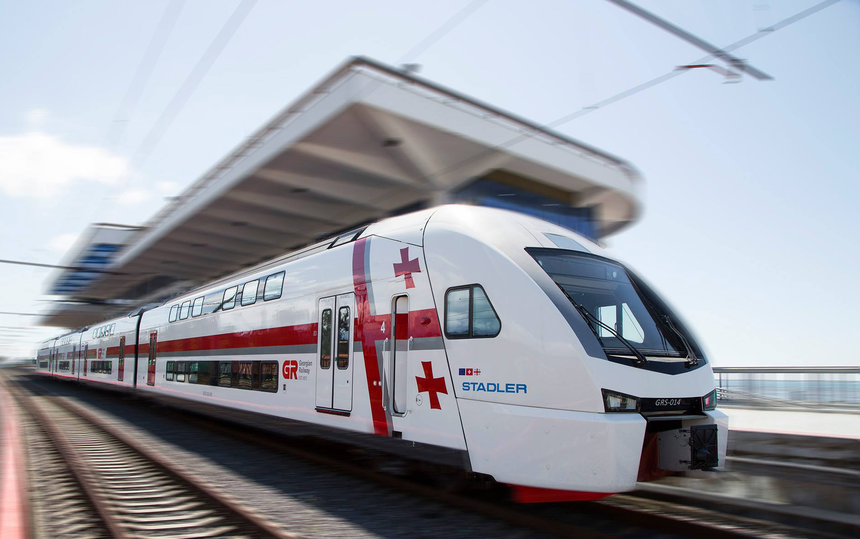




SUPPORTING GEORGIAN RAILWAY TRANSPORT
Paweł Skowroński
Resident Twinning Advisor

Slide 2

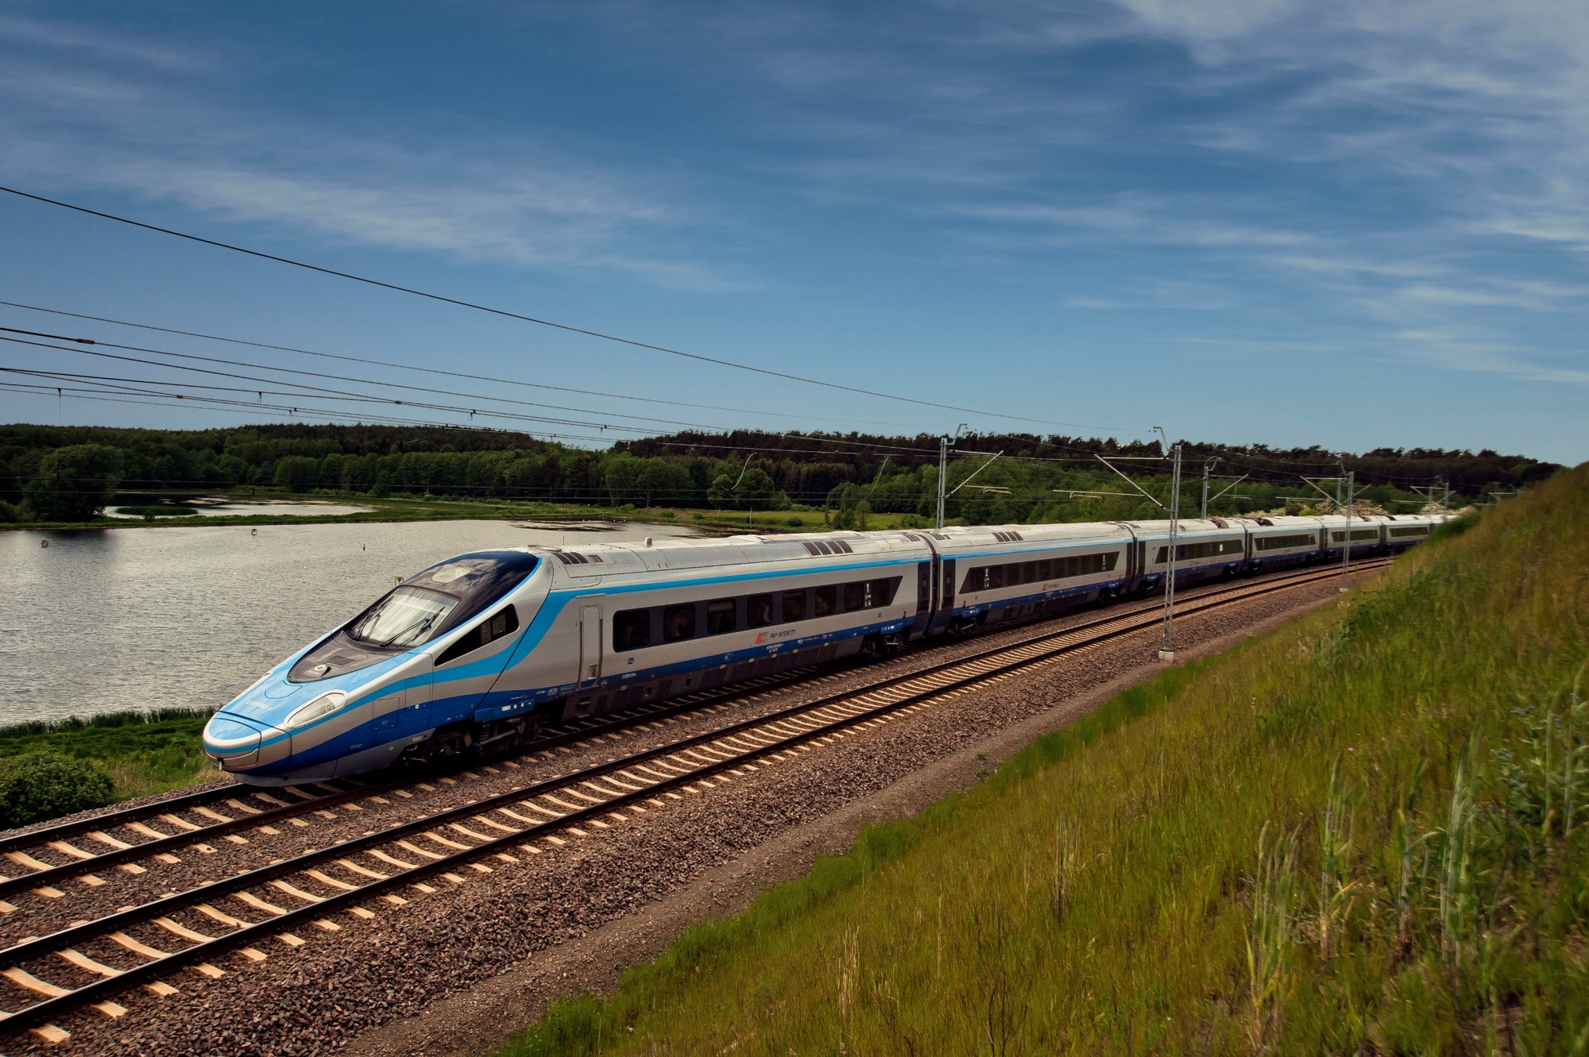
Component 1
National regulatory framework on railway transport revised and upgraded in accordance with the respective Union acquis
Fact finding missions
Gap analysis report on the Georgian legislation in the area of railway transport
Drafting missions
Review report of JSC Georgian Railway
Recommendations and guidelines on implementing the EU law
3 Concordance tables
4 annexes to Railway Code of Georgia
21 by-laws
Draft amendments to the Railway Code of Georgia pursuant to Directives 2012/34/EU, 2004/49/EU and 2008/57/EU
Super-draft

Slide 3


Component 2
A well-organized, nationally regulated railway market/sector established
Topics
TEN-T policy
Recommendations
Political and strategic goals for the operation of railway transport in the EU TEN-T network
Improving infrastructure investment process
New policy/institutions in areas of safety, interoperability and accident investigation
(future) regulatory body, licesing authority
Regulation of the railway market – approach, best practices
Public Service Obligation institution
EU rail safety and interoperability provisions
EU approach to the railway market structure
Planning, financing and executing of rail infrastructure investments
Licensing of railway undertakings
Access to infrastructure based on competition
Operation and role of intermodal terminals in international freight transport
Safety, PSO, NIB

Slide 4
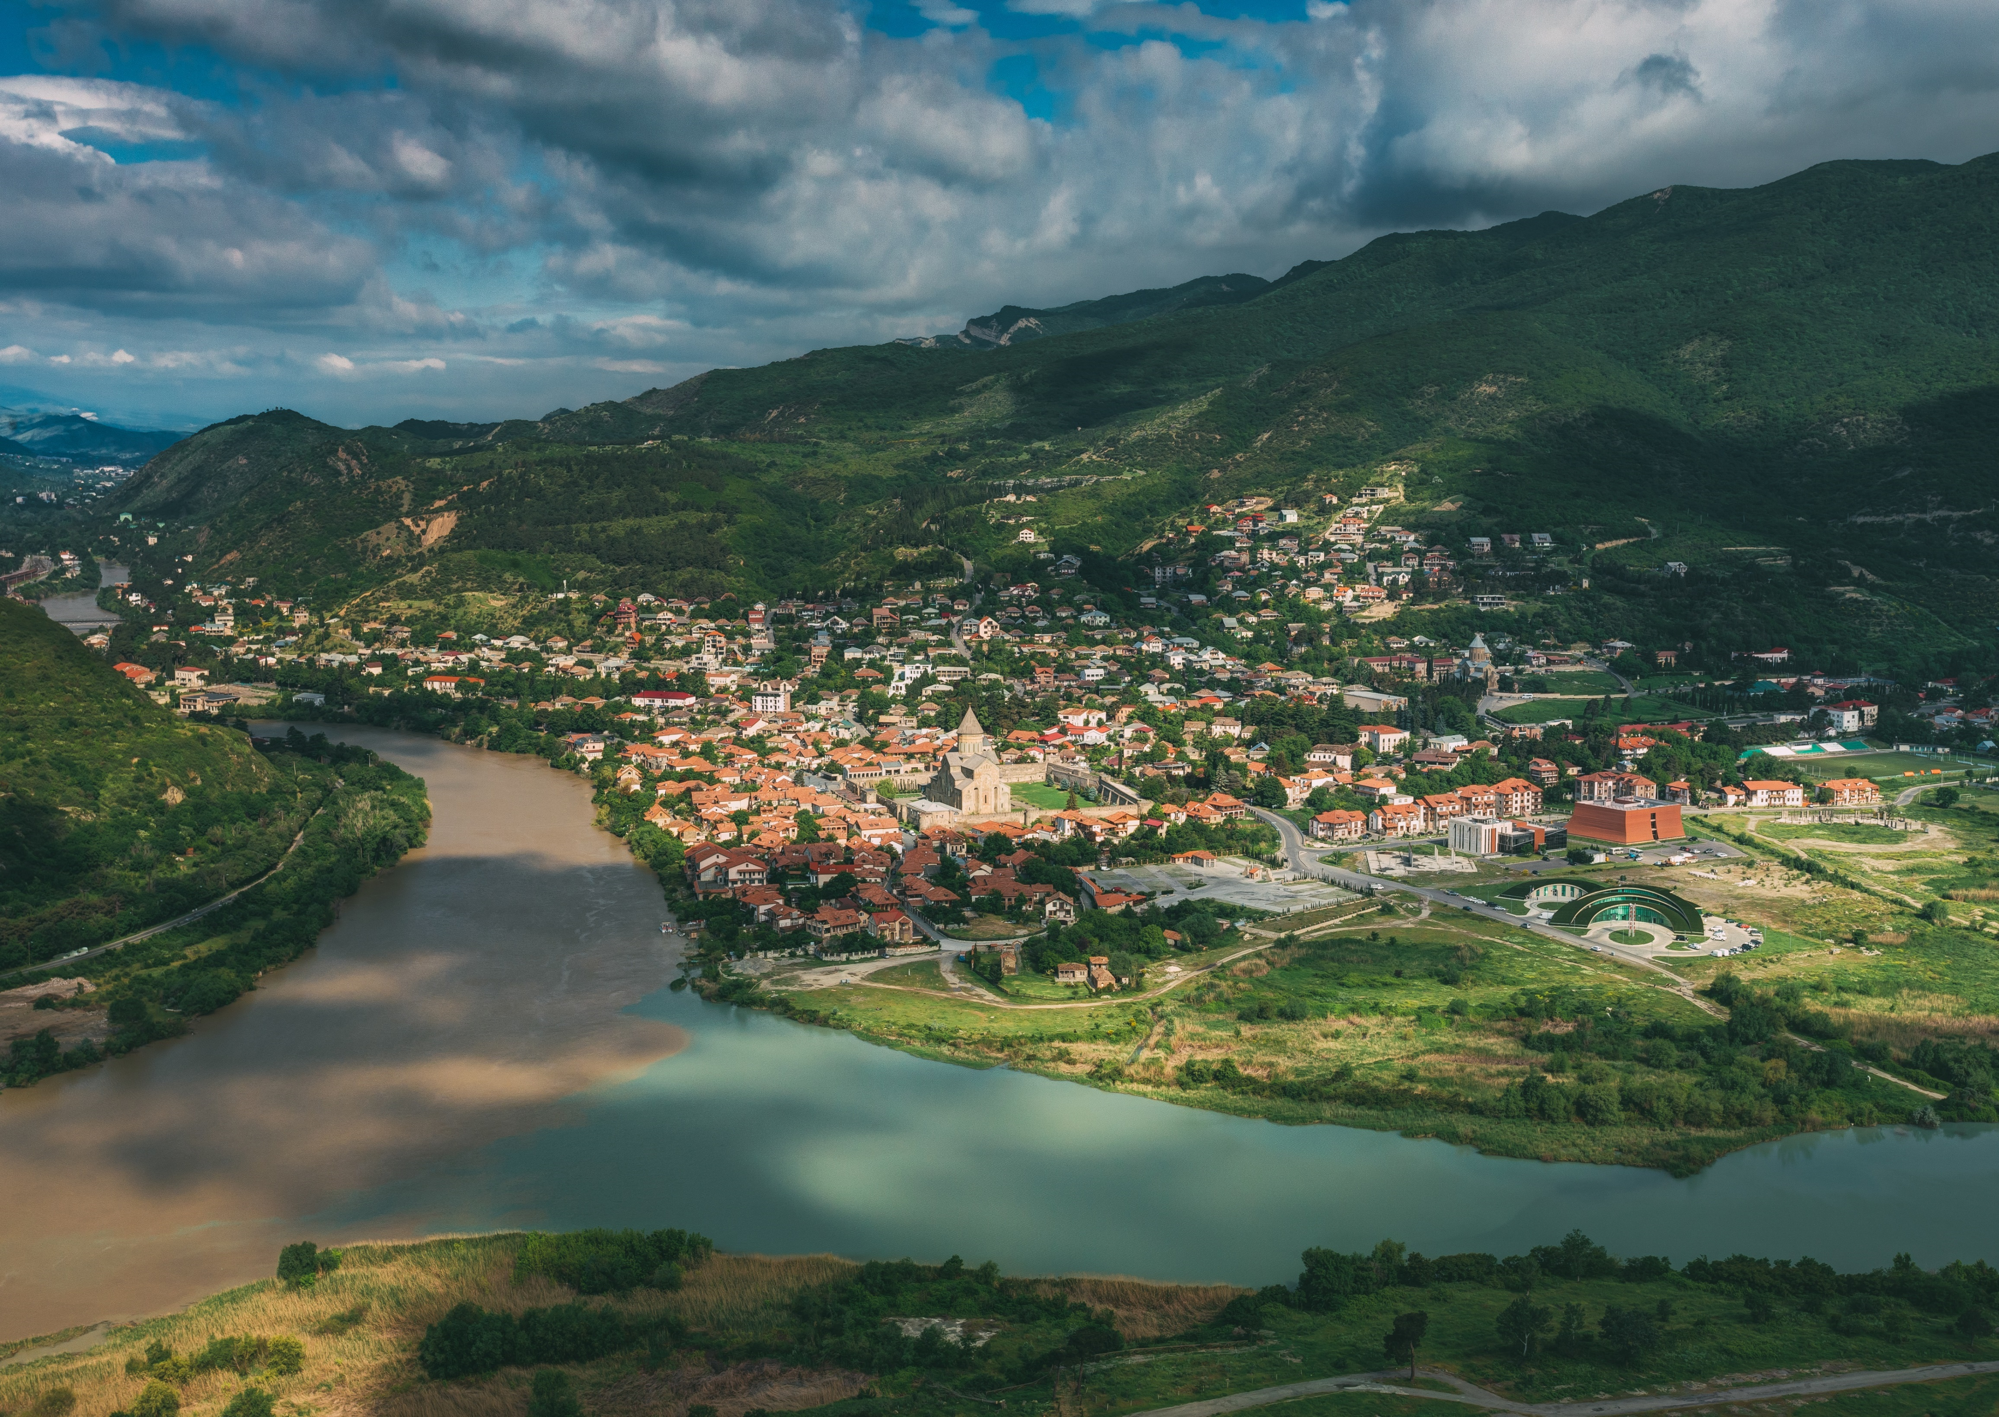

Component 3
Capacity of relevant rail authorities strengthened
Training Topics
Trainig needs Activity
Products
Training needs report
Functioning of the key institutions and bodies
Safety and interoperability
Dangerous goods
Public Service Obligation/ Contract
Conformity assessment of interoperability subsystems and constituents
Liberalization of railway market
TSIs and subsystems
MAIC
NSA, NIB functioning
Passenger transportation
Train drivers directive
18 training missions
Numerous BC experts trained (MOESD, GR)
Polish experience from restructuirng the railway sector – shared
2 stand-alone trainings on promotion and visibility

Slide 5

STE experts & Polish Railway Intitutions involved in the Twinning Project

Slide 6


Slide 7

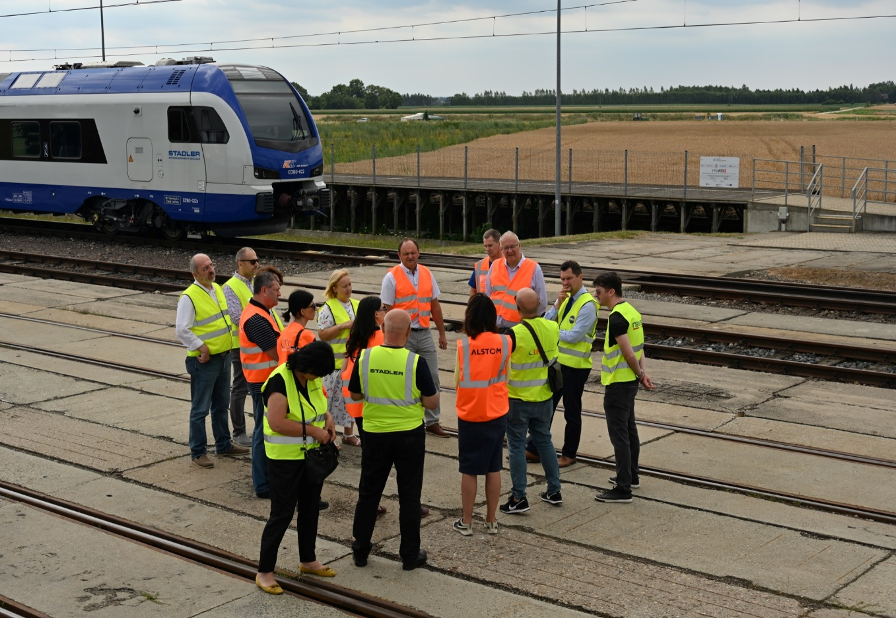
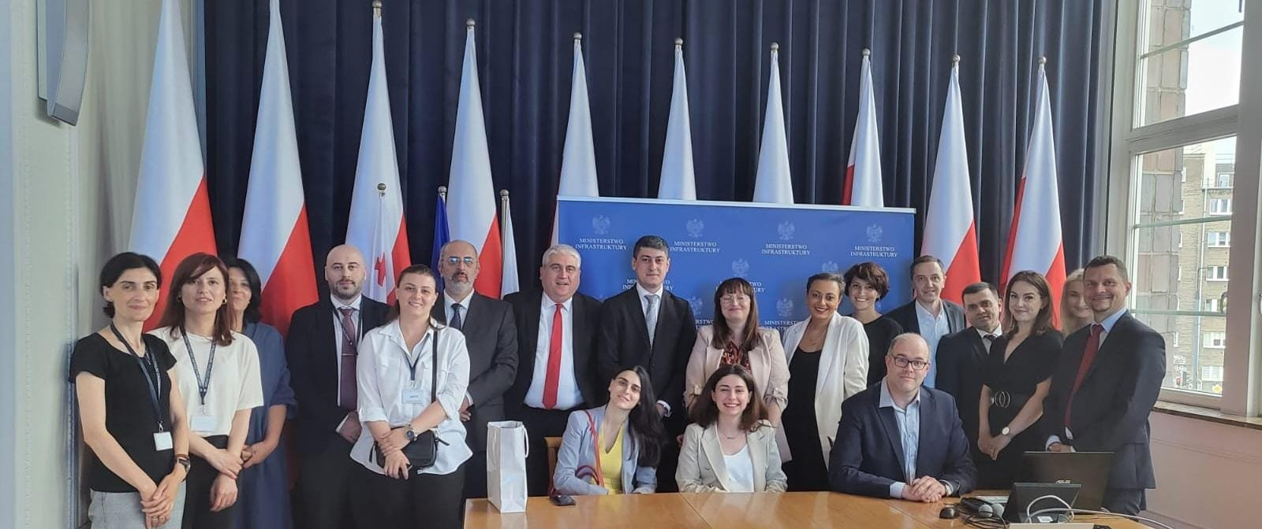
Study visits
Topics of Study Visits
Railway market functioning in accordance with the EU principles (June 2022)
Practical implementation of Safety and Interoperability Directives (July 2022)
Legislative adaptation to EU Rail acquis (September 2022)
International activities of Polish railway companies in the light of EU rail acquis (May 2023)
In Total:
20 Days in Warsaw, Wrocław, Kraków with participation of 42 BC experts
* A visit to the Żmigród Test Track in July, 2022
*Meeting at the Ministry of Infrastructure of Poland in Warsaw, June 2022

Slide 8

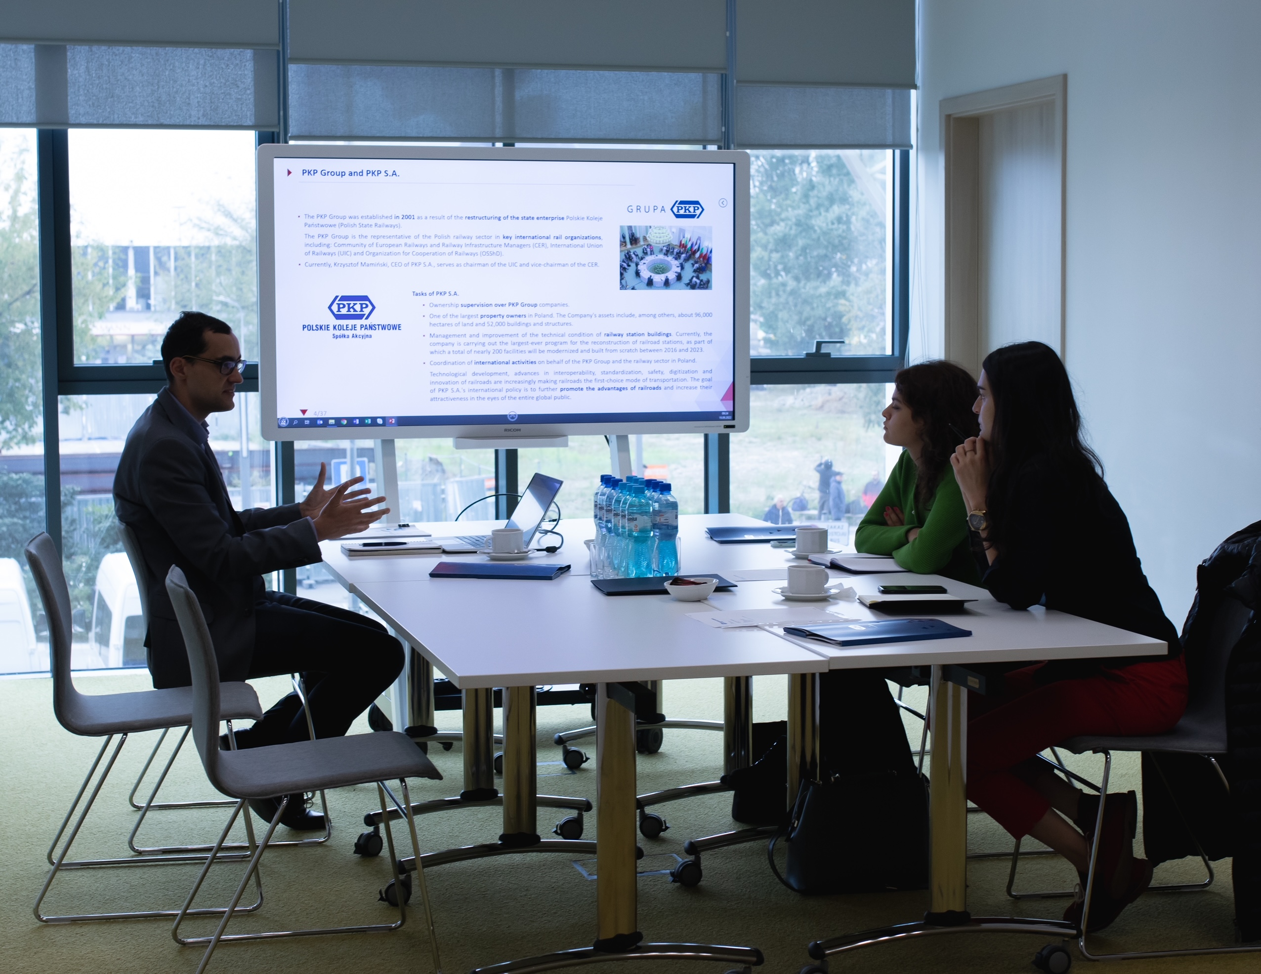
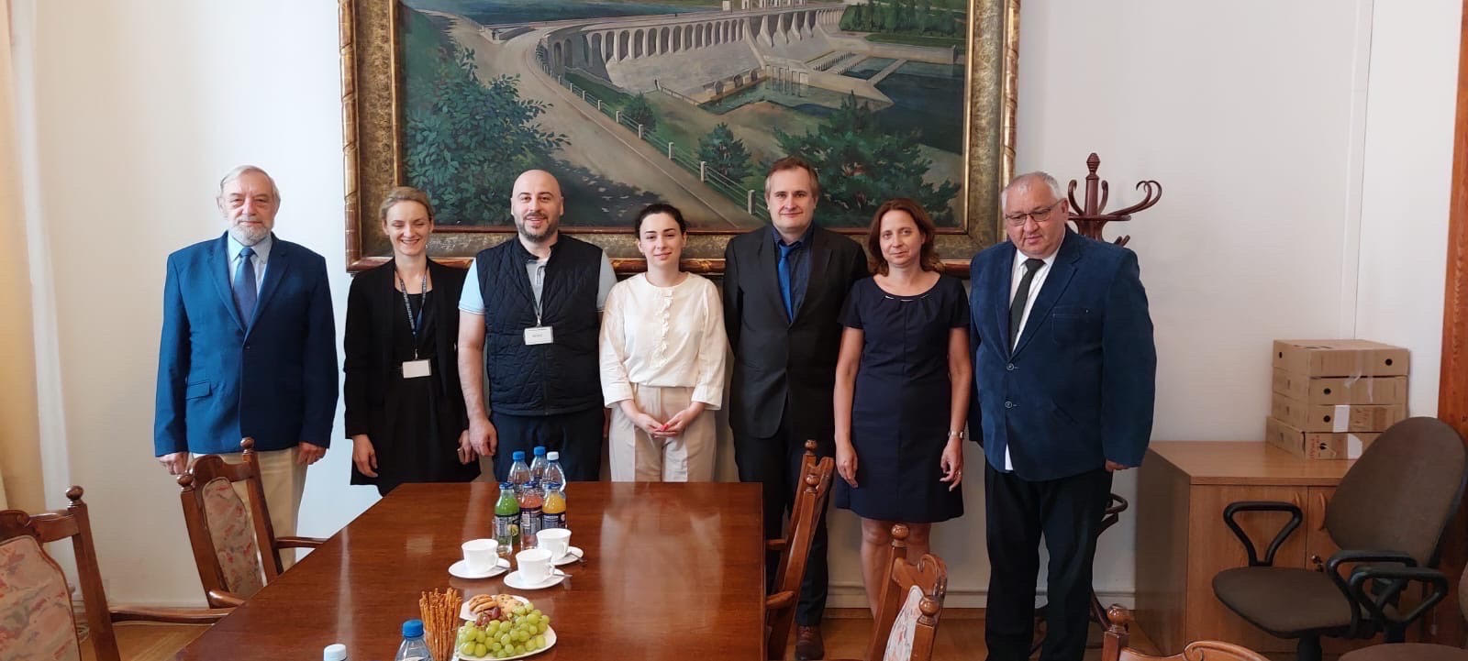
Internships
3 Internships for 6 BC representatives from MOESD and GR at the most important rail institutions of the railway market
in Poland
Ministry of Infrastructure
Centre for EU Transport Projects
State Commission on Railway Accidents and Incidents Investigation
Office of Rail Transport
Rail Research Institute
PKP Polish Railway Lines
PKP Polish State Railways
PKP Intercity
In total: 30 Days
*Meeting at PKP Polish State Railways In September, 2022
*Meeting at State Commission on Railway Accidents and Incidents Investigation in June, 2022

Slide 9

Work Plan
3 Study visits
50 missions
As per
5 Side-letters &
3 Addendums
4 Study visits
56 missions
Project timeline
28,5 months
MoU
Project timeline
24 months

Slide 10


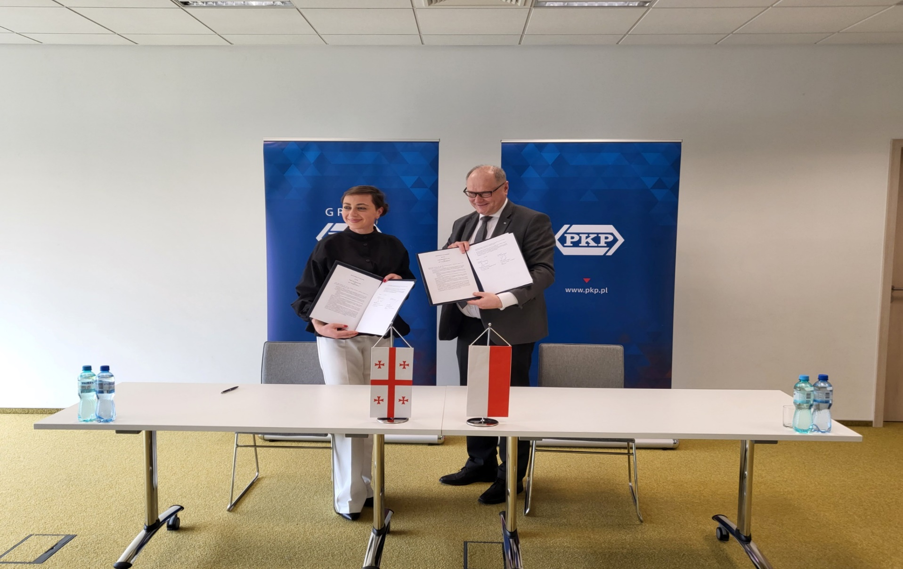
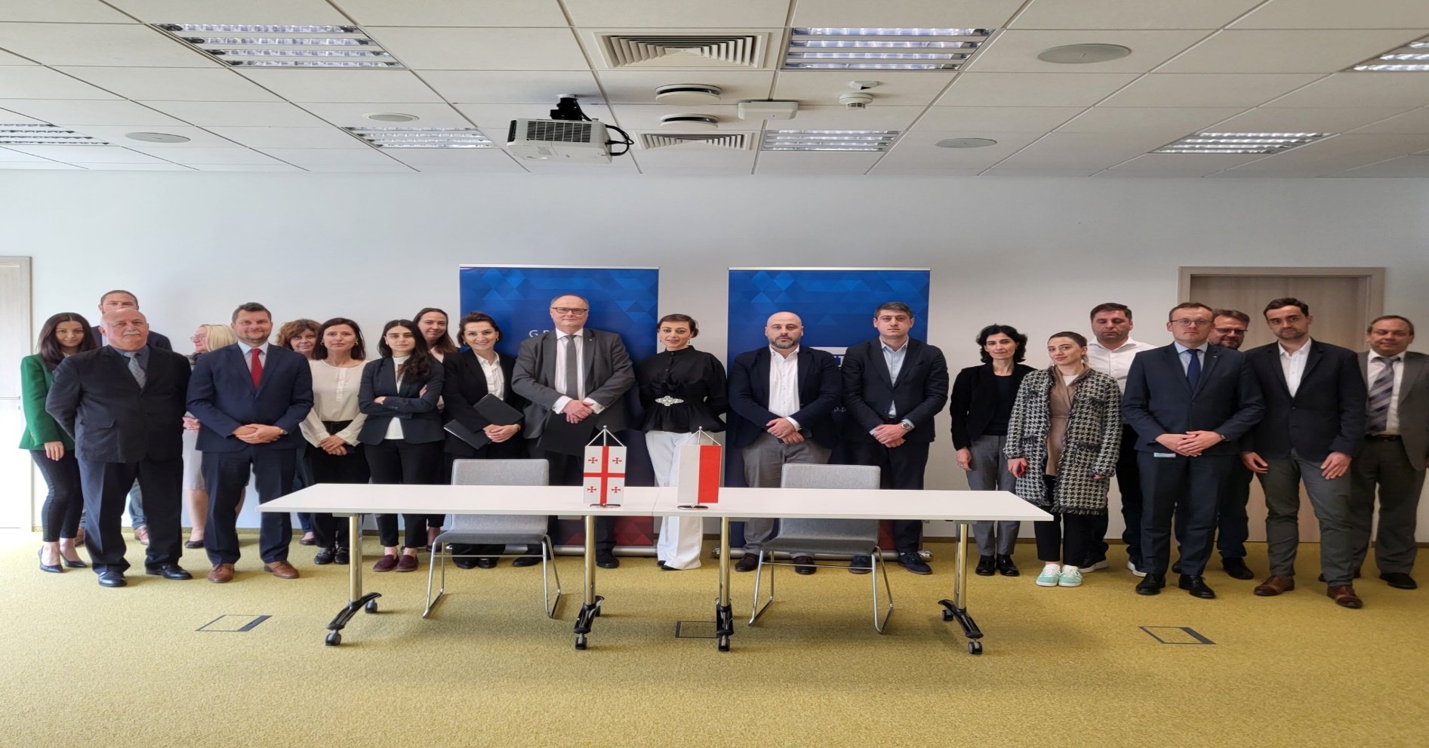
* The MoU was signed by Mr. Władysław Szczepkowski, Plenipotentiary of the Management Board for Corporate Affairs, Polish State Railways JSC and Ms. Nino Jorbenadze, Chief Operational Officer, Head of Corporate Affairs Department, JSC “Georgian Railway”.
Warsaw, May 18, 2023
Signing of Memorandum of Cooperation (MoC)
between Polish State Railways JSC and JSC “Georgian Railway” on the development of railway transport links connecting Poland and Georgia

Slide 11

What this Twinning meant to me?
Unprecedented partnership
High level professionals
Exceptional dedication to join the EU
High commitment to European obligations
Heated discussions
Strong network
Amazing views through the windows of Georgian trains
Special Friendships
Unforgettable memories
Sunny Days
Enthusiasm
Devotion

Slide 12
Organizacja projektu w Ministerstwie
Zarządzenie DG
Umowy z instytucjami lub ekspertami indywidualnie
Obsługa administracyjna i księgowa projektu -> MI
Elementy promocyjne projektu -> MI
Umowa cywilnoprawna z RTA (+ urlop bezpłatny), wynagrodzenie, diety, dodatek lotniczy – opodatkowane
Eksperci -> FDAs (+ew. DSAs) – opodatkowane, z wyjątkiem kosztów noclegu
Pracownicy obsługujący projekt -> wynagrodzenia (nagrody) ze środków projektowych
Przedłużenie projektu o 4,5 miesiąca (środki częściowo z kosztów pośrednich) -> na budget headings RTA oraz Mandatory results

Slide 13
Inne kwestie
Zaangażowanie MI w projekt – kwestia decyzji i następnie przebiegu
Przygotowanie oferty – współpraca z CUPT i MFiPR
Silna oferta (kilkudziesięcioro ekspertów, kilka instytucji, PL, RTA i CLs)
Ok. połowa projektu – zdalnie (marzec 2021 – maj/czerwiec 2022)
Misje osobiste – lepsze
RTA team – zdalnie/hybrydowo przez cały czas (mimo że biuro zapewnione)
W zakresie misji –> hybryda – najwygodniejsza formuła
3-4 ekspertów na misję
Project Managers w EUD
Zaangażowanie strony gruzińskiej (w tym „widoczność” projektu)
Kwestia unijna vs. rosyjska
Gruzja jako kraj

Slide 14
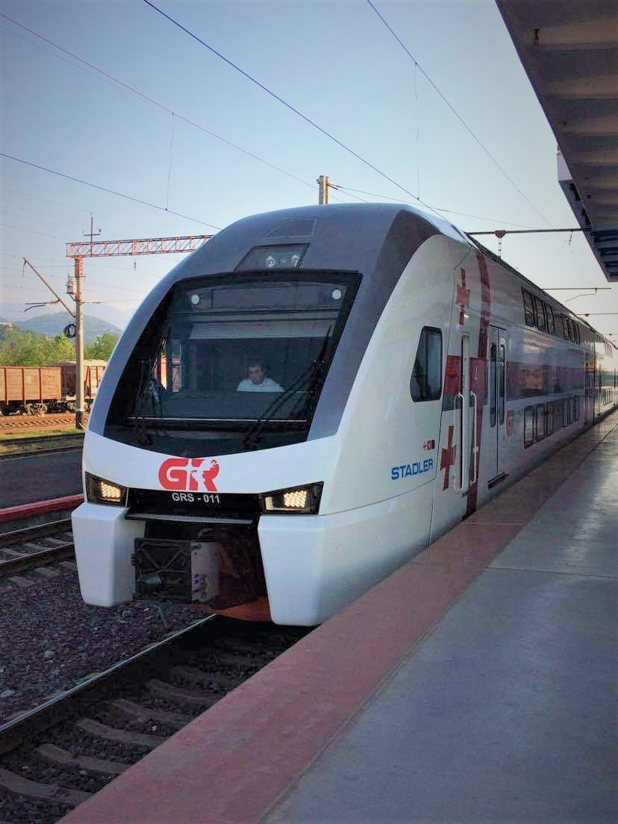

Contacts
Paweł Skowroński
Resident Twinning Advisor
+48505060664
pawel.skowronski@mi.gov.pl
Ministry of Infrastructure
Address:
ul. Chałubińskiego 4/6
00-928 Warszawa
Tel: +48226301000
Email:
twinning-georgia@mi.gov.pl
This presentation has been produced with the assistance of the European Union.
Its contents are the sole responsibility of the author and do not necessarily reflect the views of the European Union.

